Slide 1
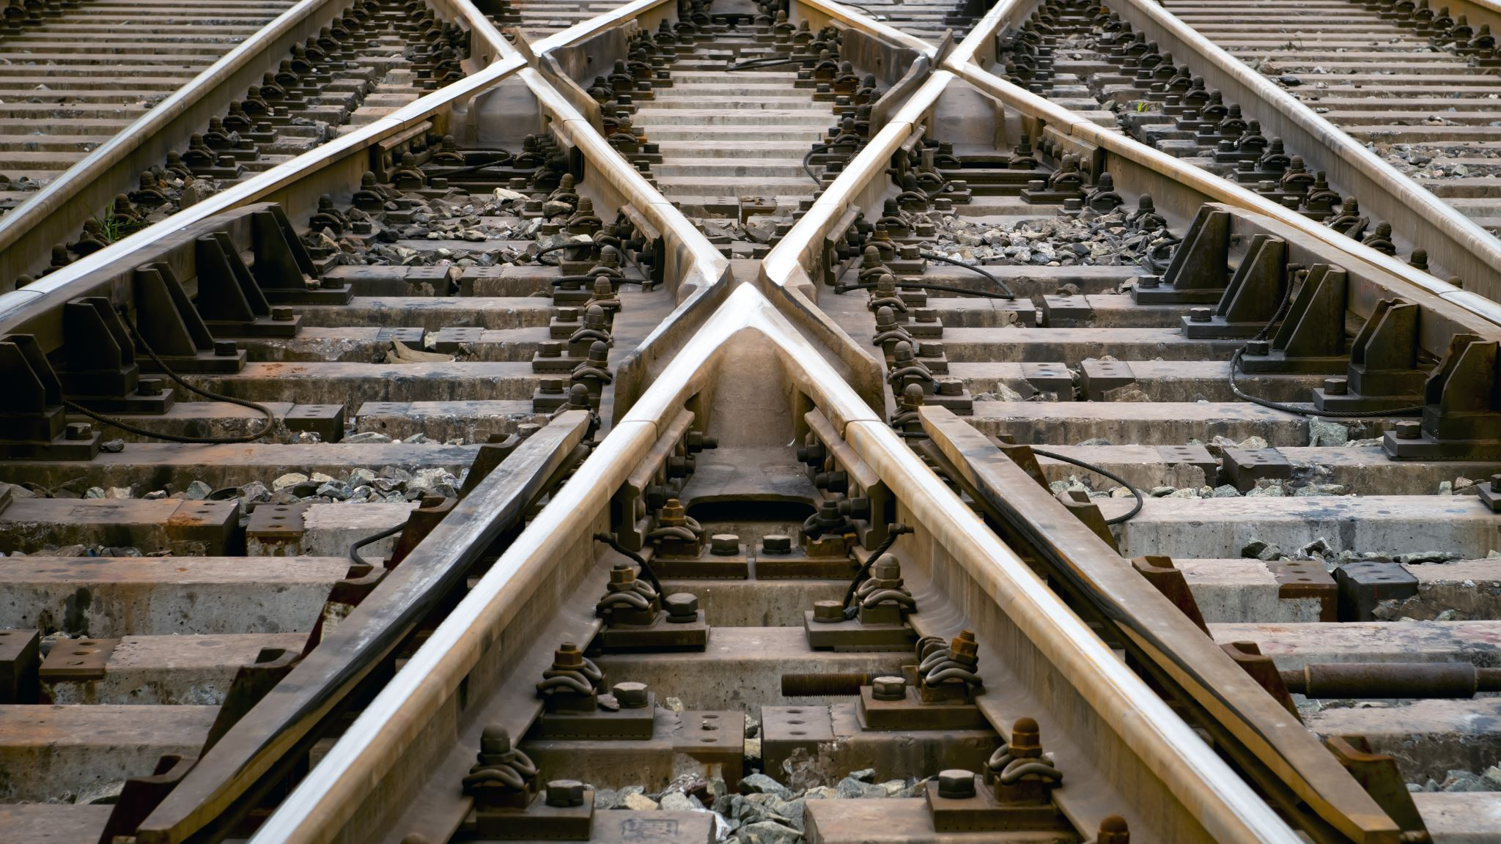
Online Railway Reservation System

Slide 2
Design Pattern
Angular - Creating a user interface (Front-end) , Contains Html CSS And TypeScript files and Communicate with API
API - Using HTTP requests, we will use the respective action to trigger various operations
Database - For storing, maintaining The data Efficiently

Slide 3
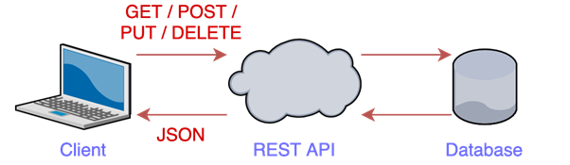
Solution Diagram

Slide 4
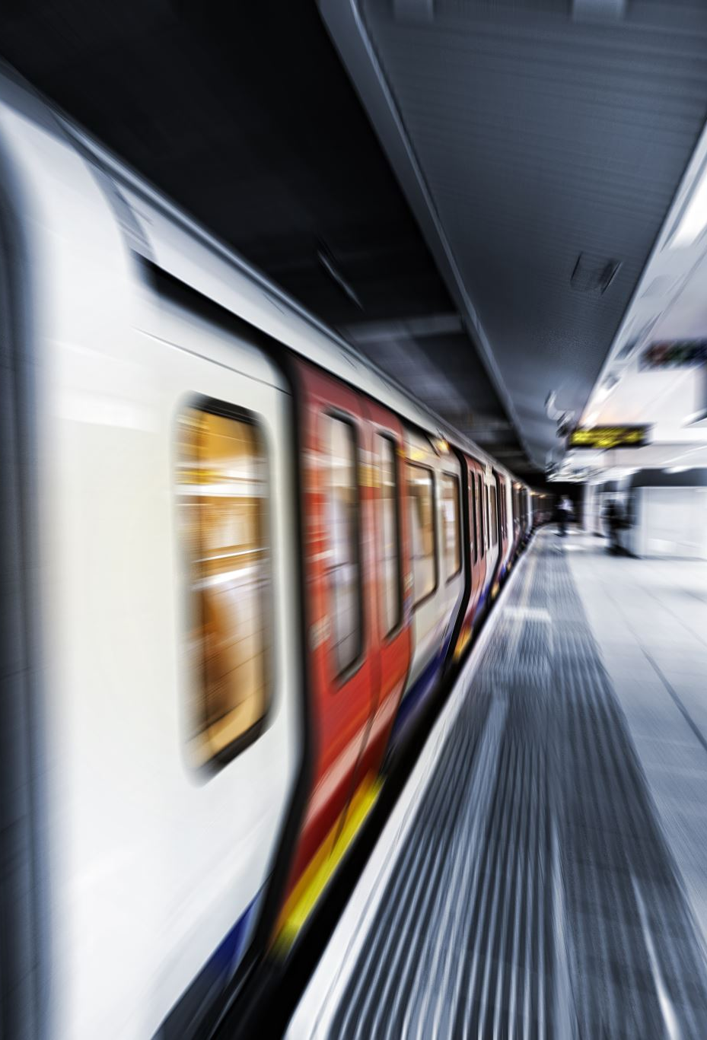
Admin
Edit and add new train and fare details
Can add and edit seats for the trains
See all trains
See the Customer Details

Slide 5
User
Registering User
Viewing Train and Fare Details
Booking of tickets
Cancellation of tickets

Slide 6

Class
Model - Storing Schema for all the tables
Interfaces - Maintaining the structure of the classes
Controllers - Mandle the HTTP Requests
Services - Logic and communications between the controller and repository Layer.

Slide 7
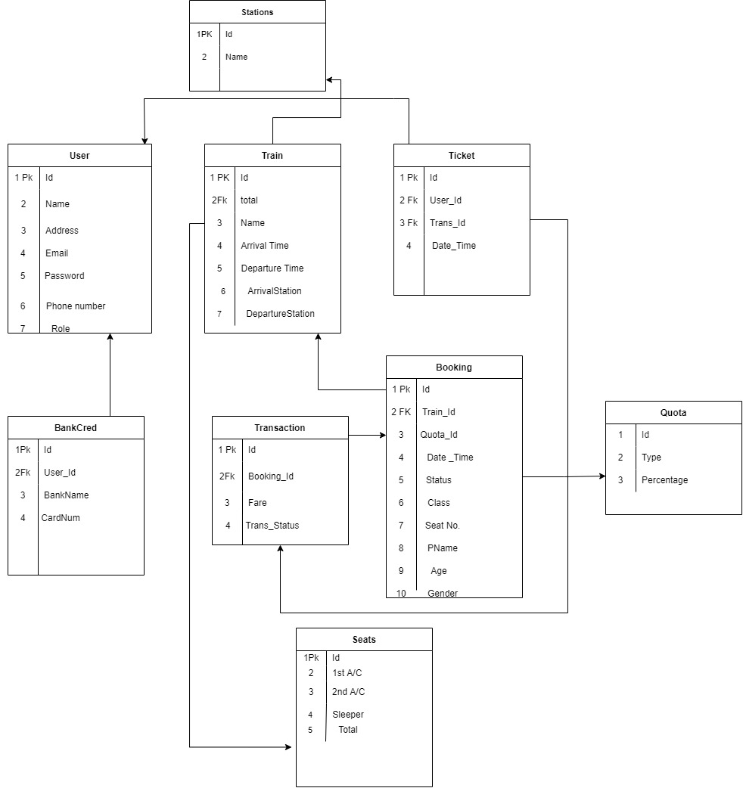
Database Diagram

Slide 8
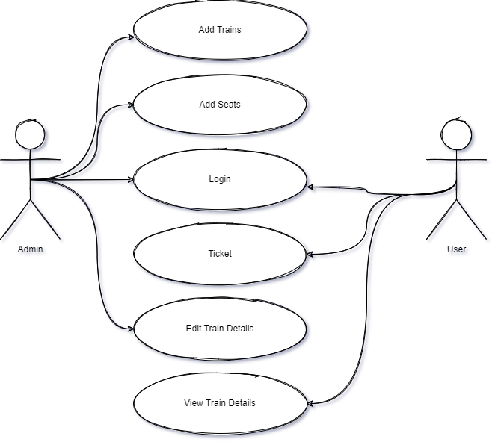
Use Case Diagram

Slide 9

Thank You

